Slide 1
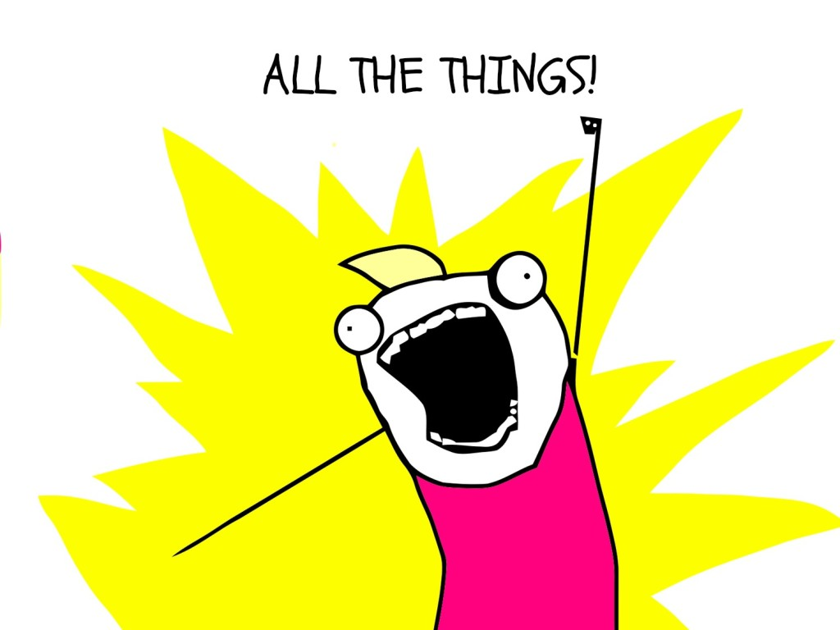
NPM CLI:

Slide 2
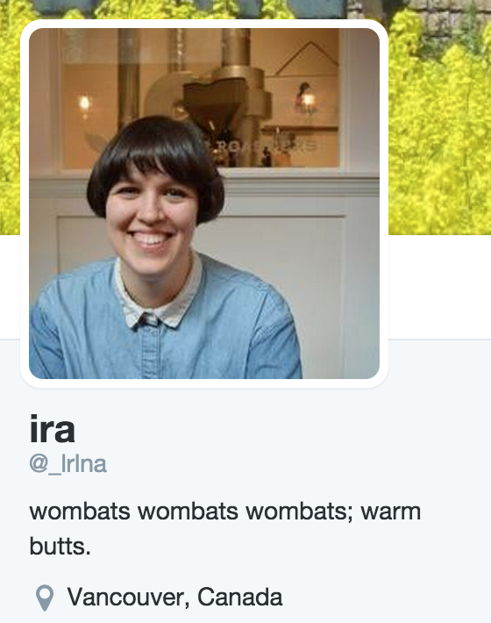
Hello, my name is:
@lrlna
Software Dev @ Monstercat
IRL:
Mentor @ Ladies Learning Code

Slide 3
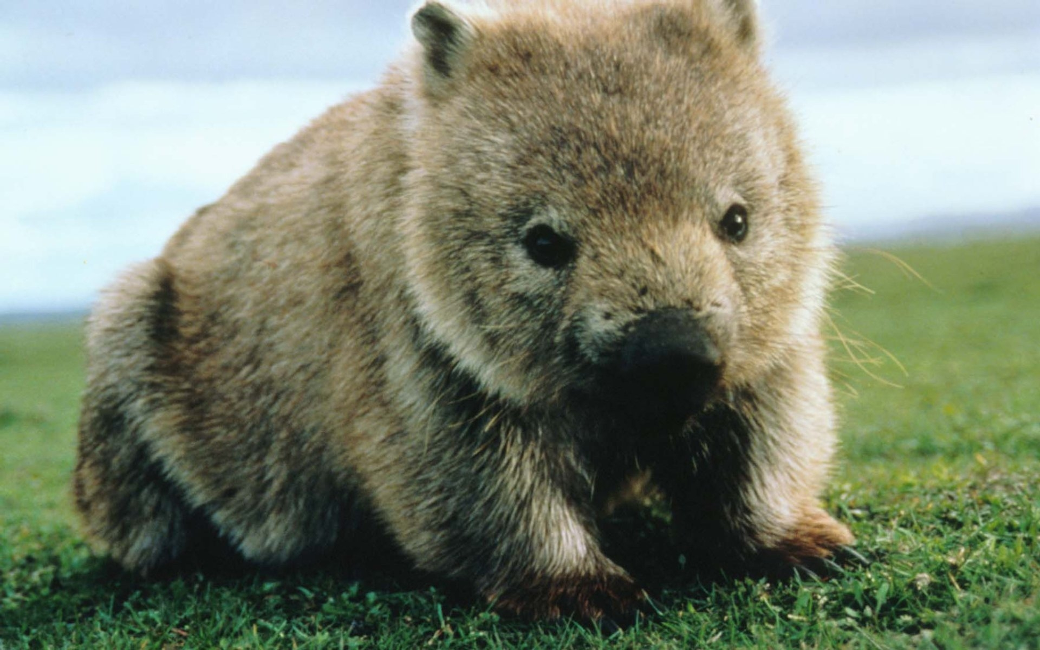
DISCLOSURE!
* no animals were hurt in the making of this program

Slide 4
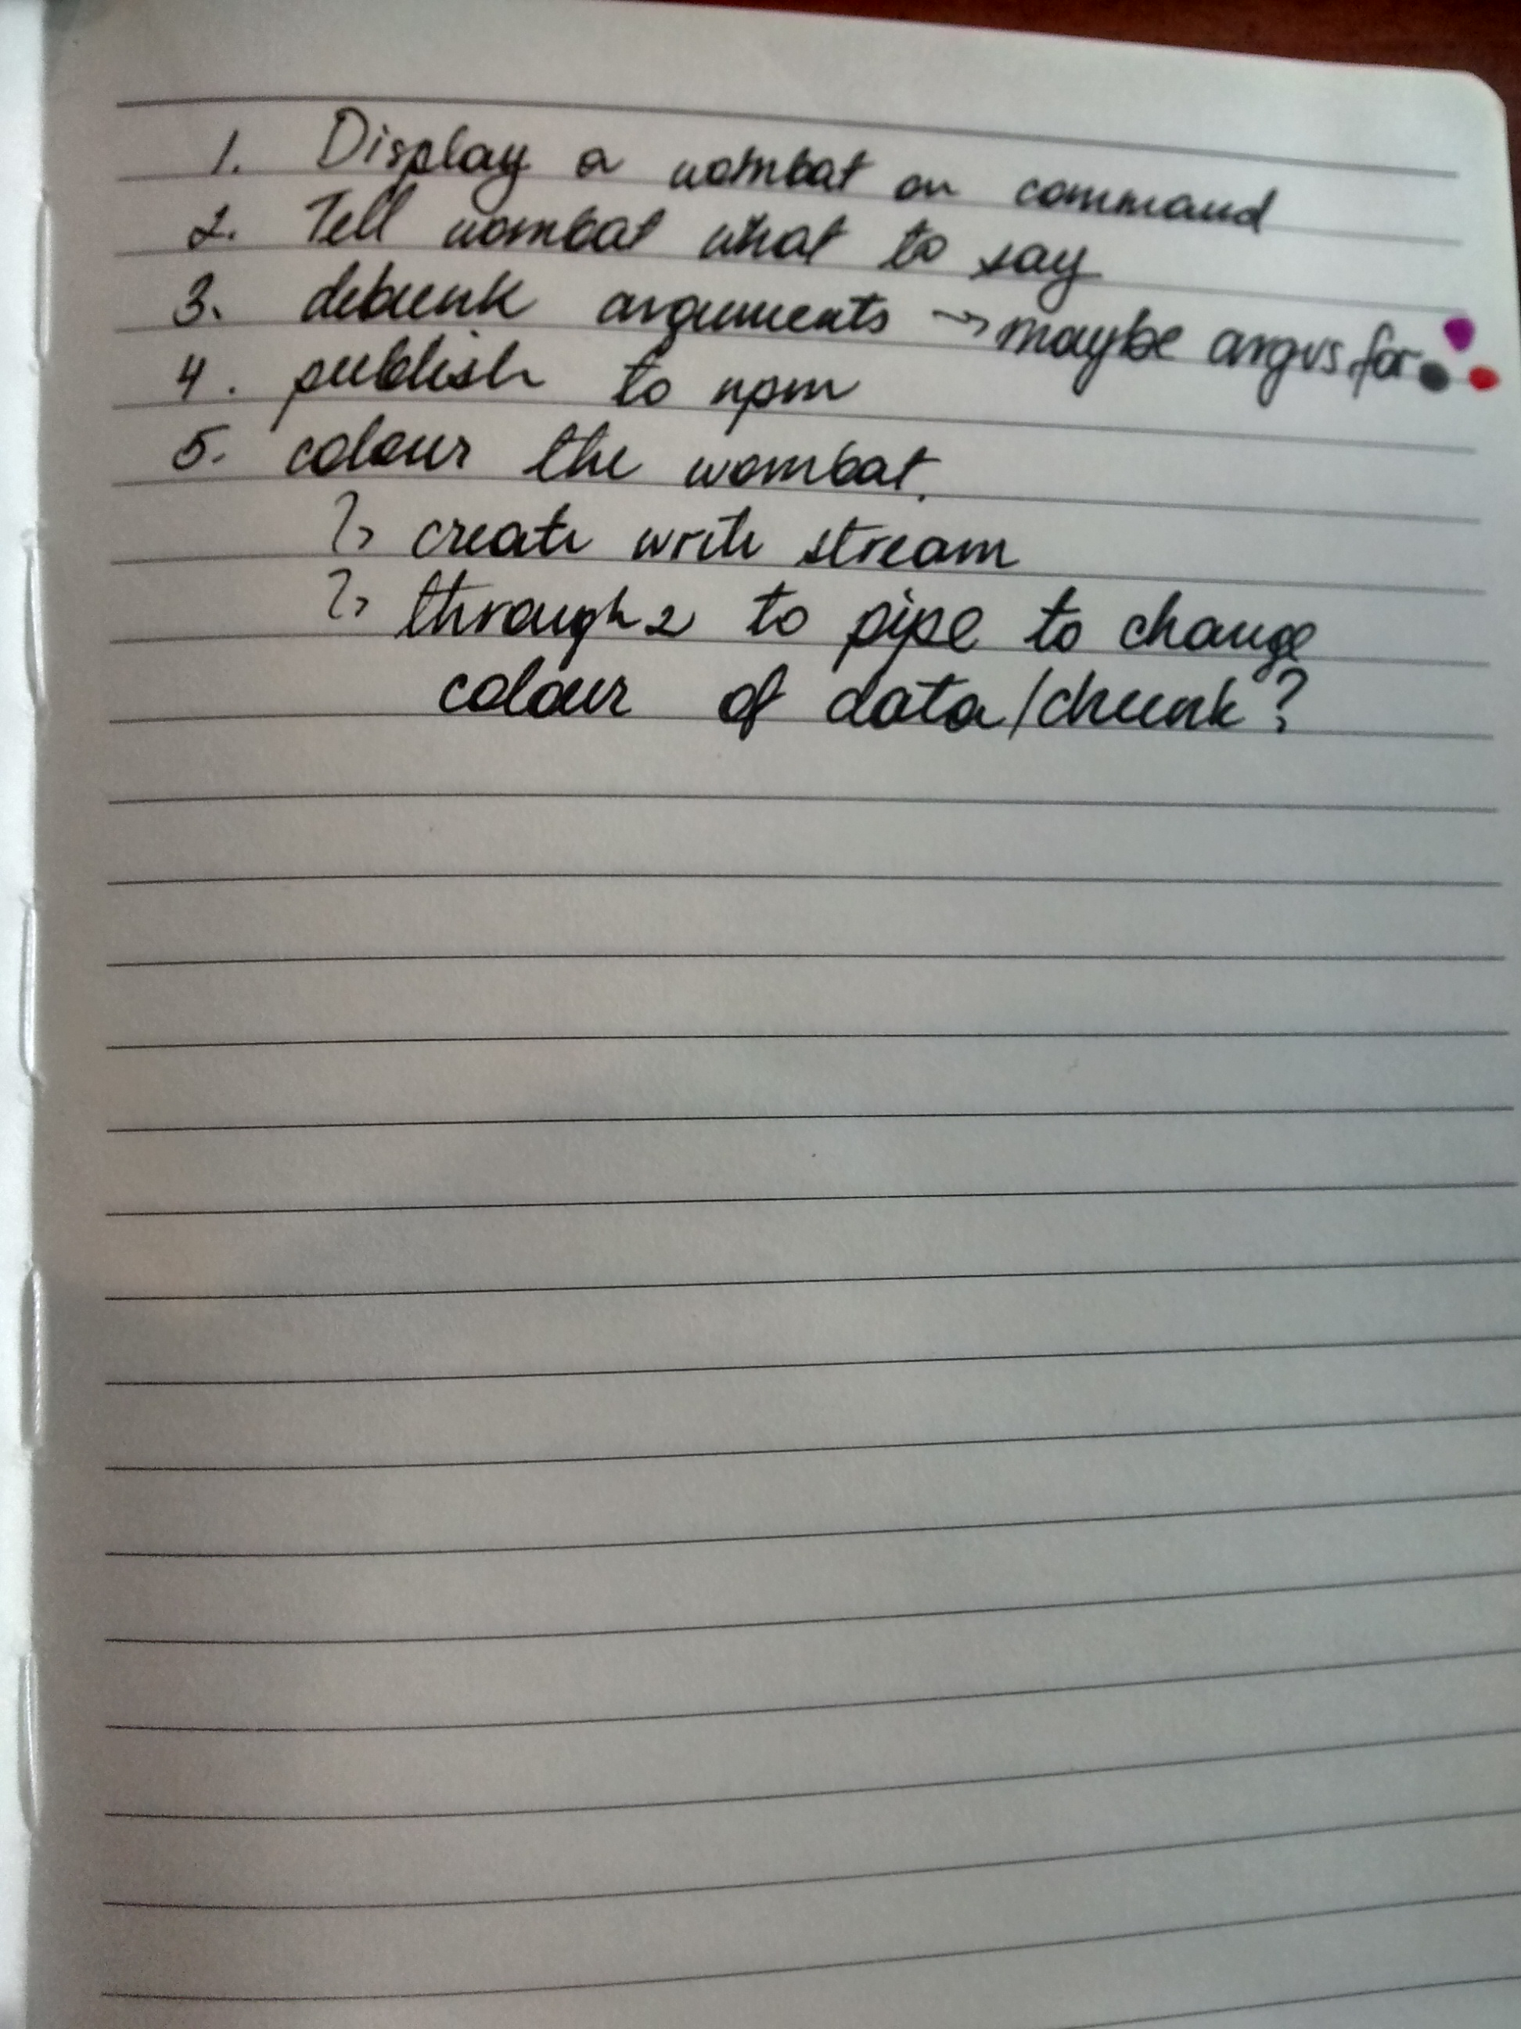
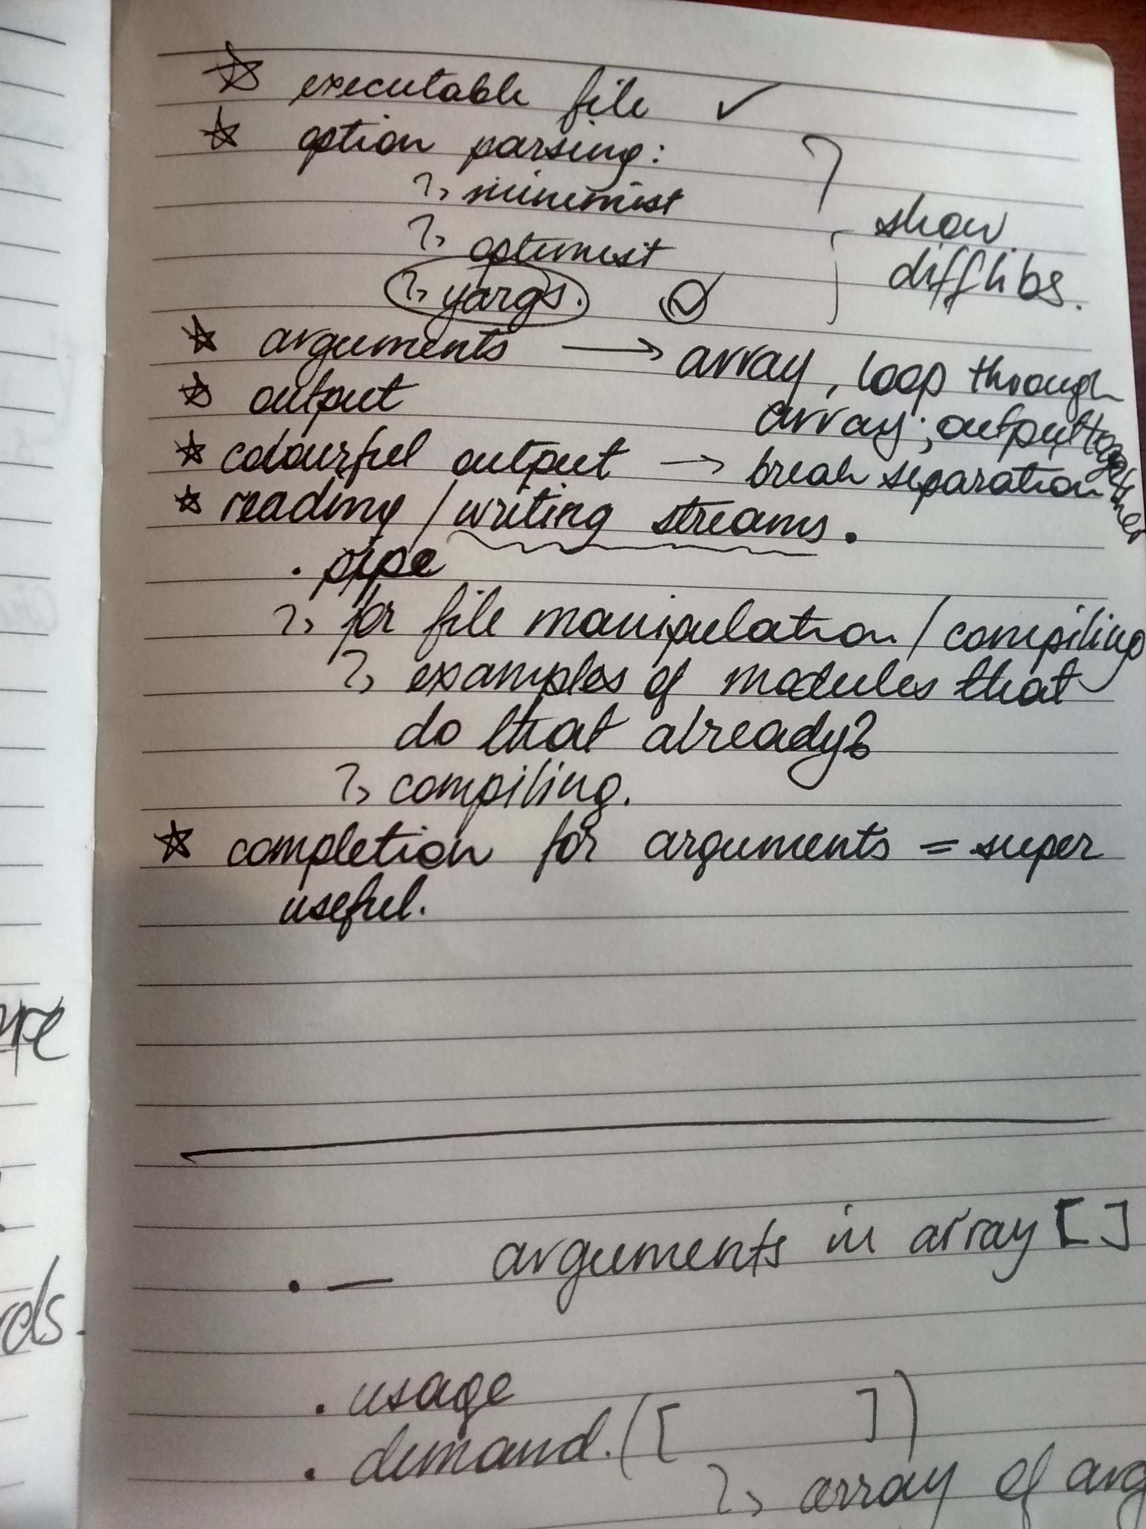

Slide 5
CLI Basics
Executable File
Options/Commands
Arguments
COLOUR!
Completing Arguments
Publishing

Slide 6
Here is what we are building!

Slide 7
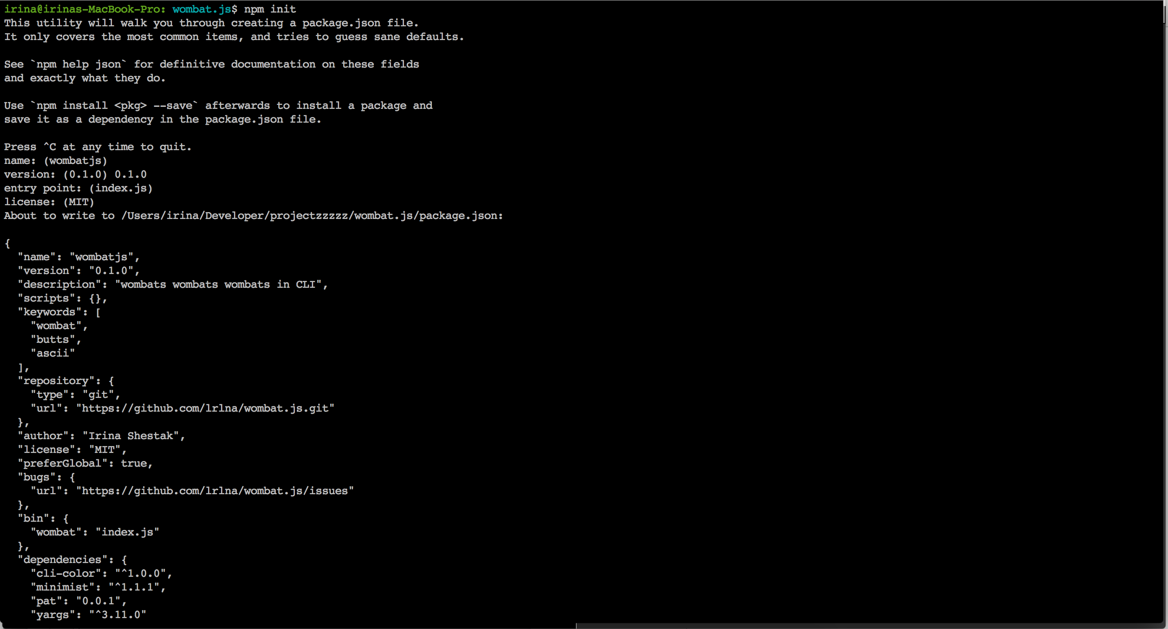
Starting Off:
npm init

Slide 8
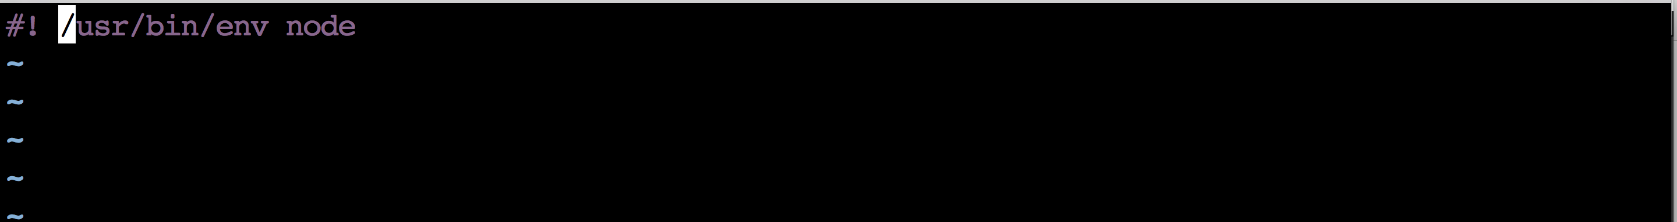
Starting off:
Executable File

Slide 9
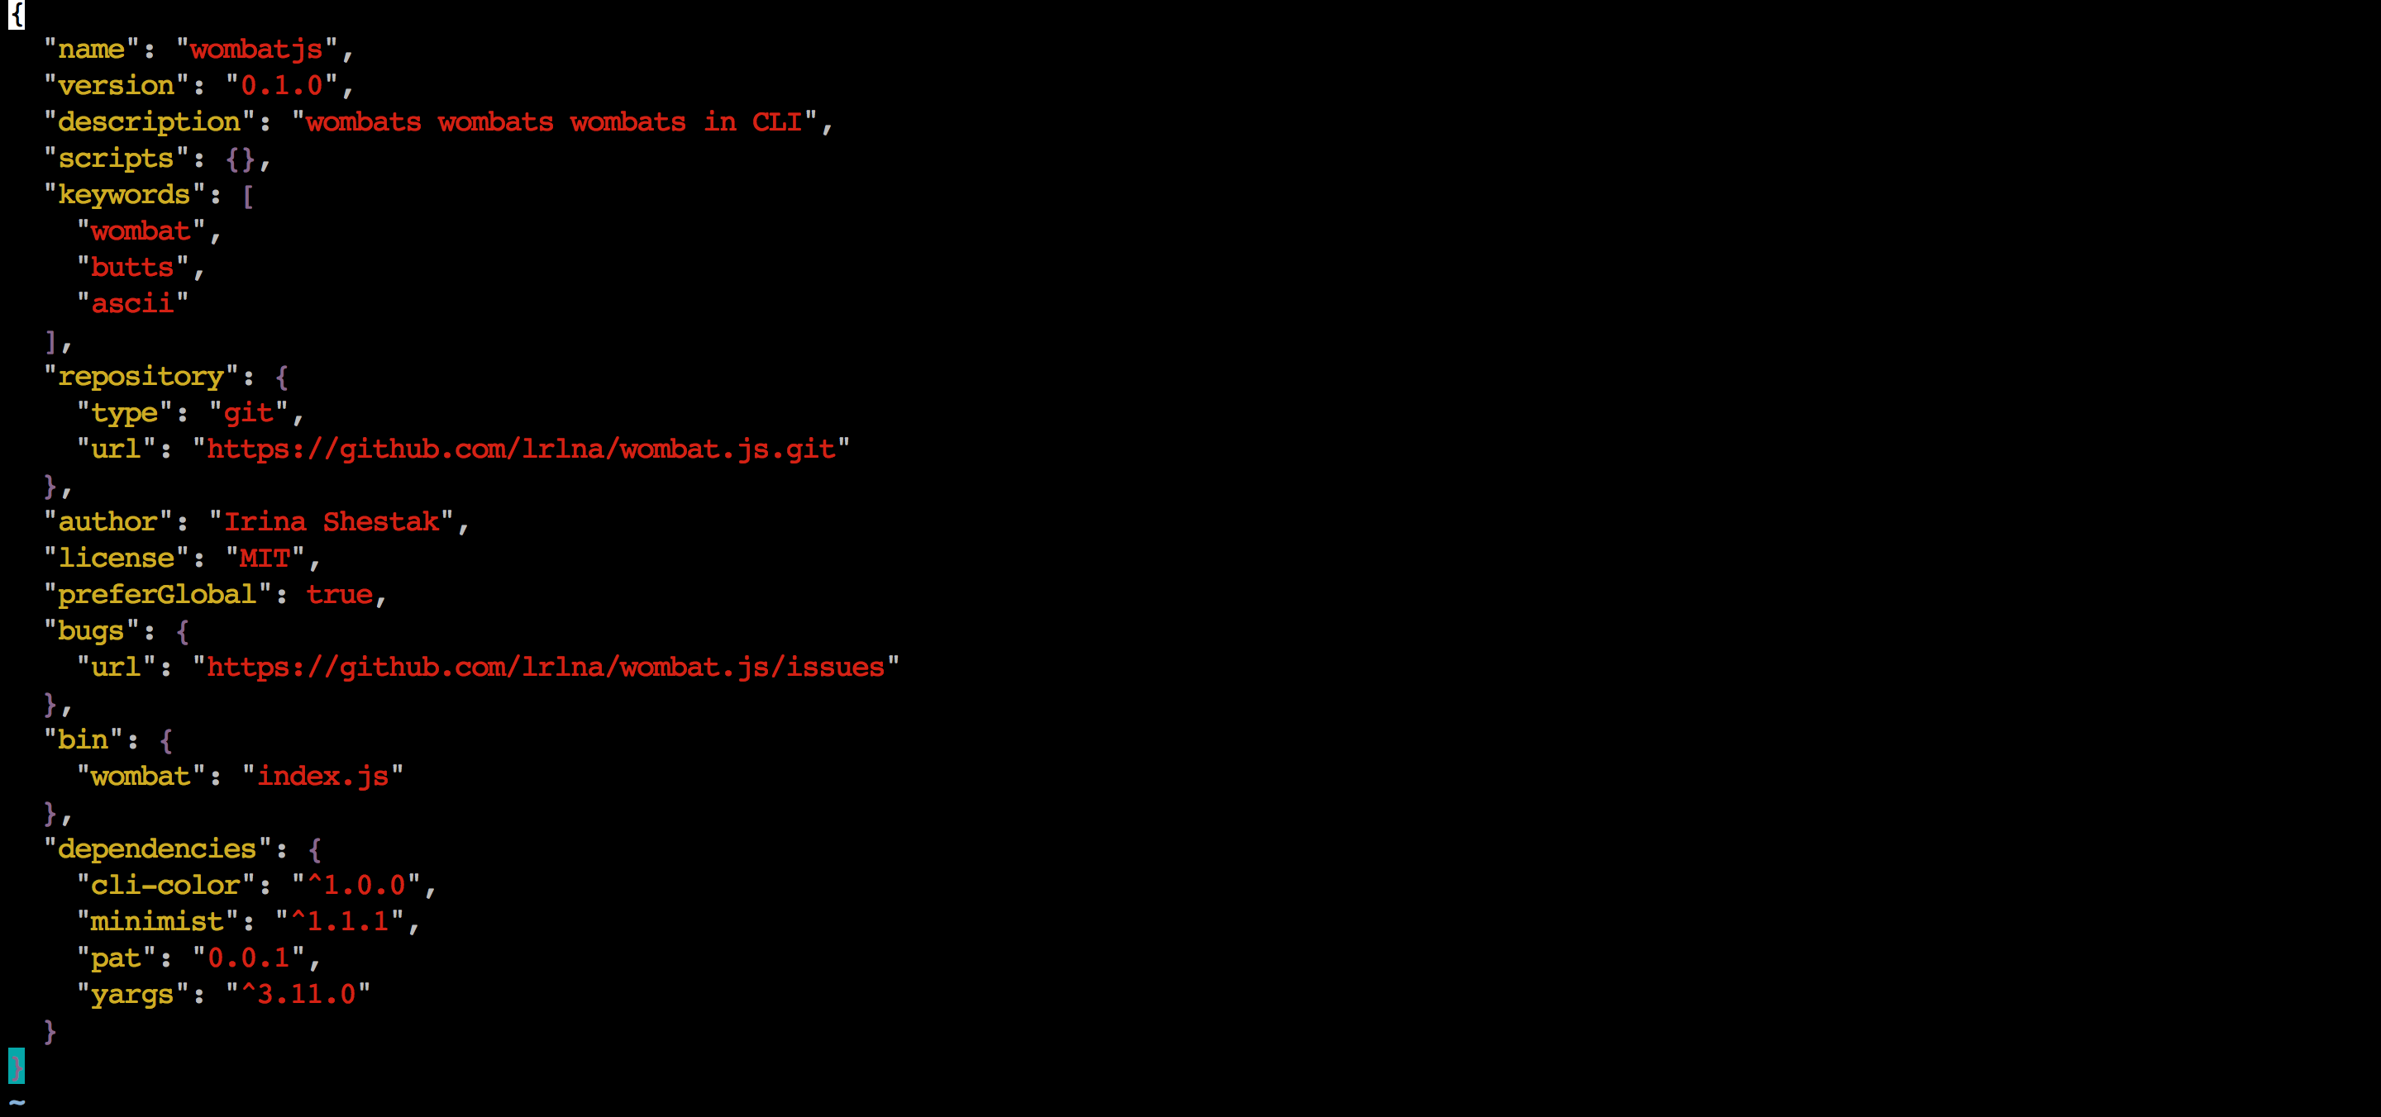
package.json

Slide 10
Starting off:
Executable File

Slide 11
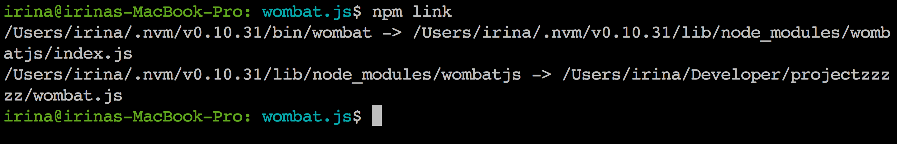
Starting off:
Executable File
npm link

Slide 12
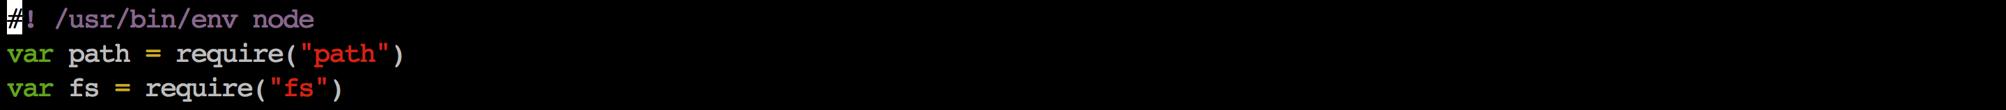
Reading files!

Slide 13
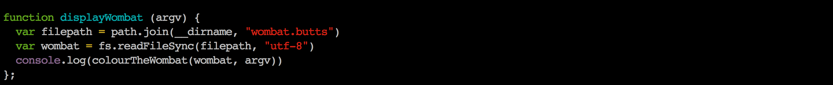
Reading files!

Slide 14
Option + Argument Parsing!
Minimist
Optimist
Yargs
Others?

Slide 15
Option + Argument Parsing!
Minimist
Optimist
Yargs
Others?

Slide 16
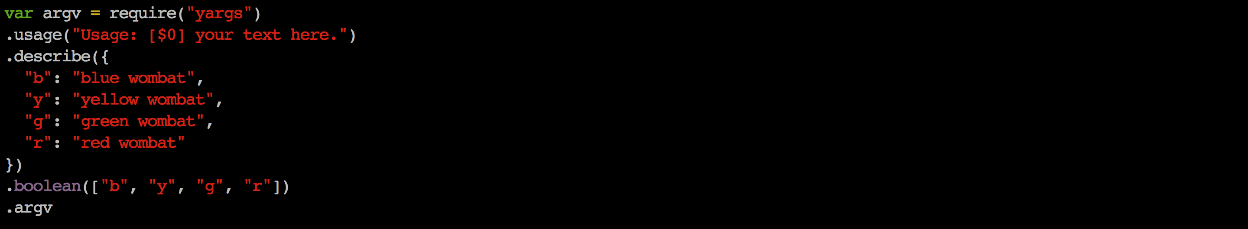
Using the arguments!

Slide 17
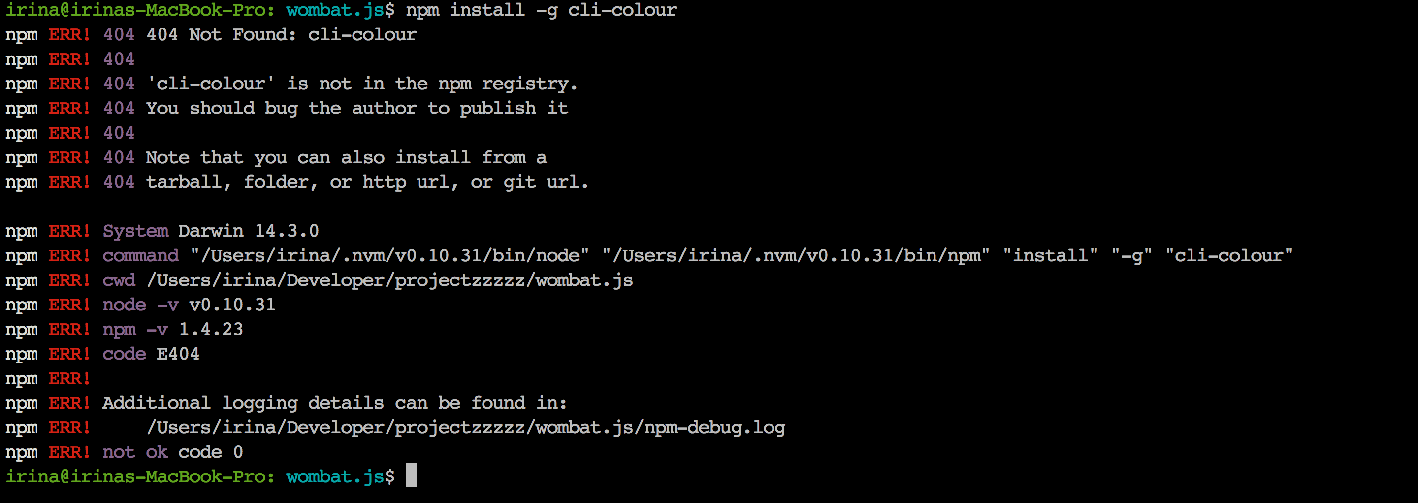
ALL THE COLOURS
cli-colour

Slide 18
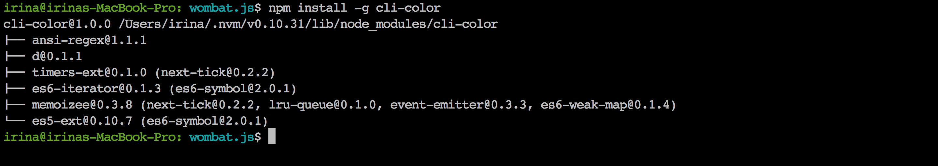
ALL THE COLOURS
cli-colour cli-color

Slide 19

ALL THE COLOURS
cli-colour cli-color
and magic!

Slide 20
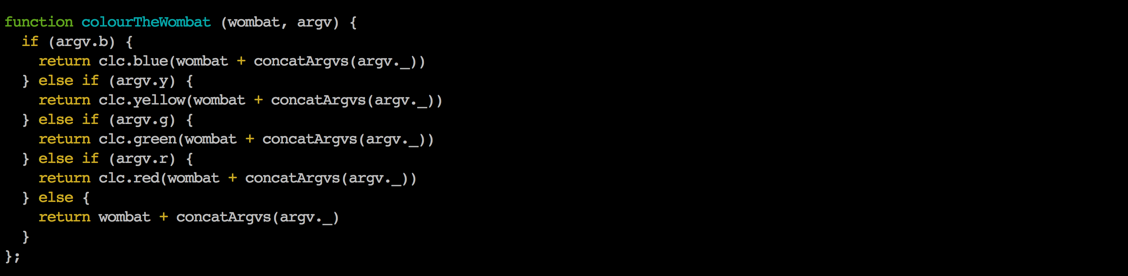
Use the colour

Slide 21
Publishing.
Super complicated procedure is….

Slide 22
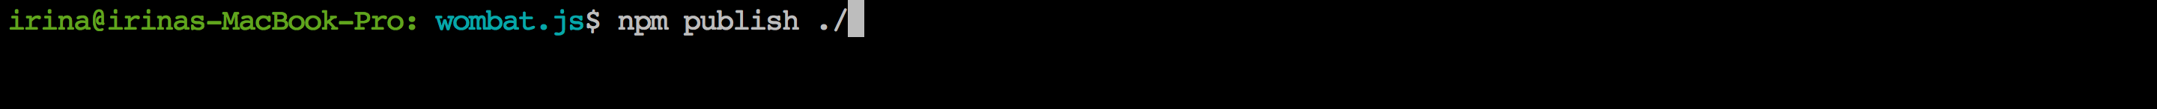
Publishing.
Super complicated procedure is….

Slide 23
But what do I need CLI things for?

Slide 24
Resources
RESOURCES:
GIST
Your own wombat at home:
npm install wombatjs

